Slide 1
RECOVERING FROM THE GREAT RECESSION:HOW HAS AMERICA BOUNCED BLACK?
Name
Institutional Affiliation
Course Code
Date

Slide 2
Introduction
The Great Recession is about falling housing prices, rising default and foreclosure rates, failure of large investment banks, and huge bailouts arranged by both the Fed and the Treasury
The crisis reduced the wealth of most Americans and generated widespread concern about the future of the economy
This crisis and the response to it may be the most important macroeconomic event of the lives of Americans

Slide 3
Key Events Contributed to the Great Recession
Boom and bust in housing prices
Rising default and foreclosure rates
Sharp downturn in the stock market
Soaring prices of crude oil and other energy sources

Slide 4
How the United States Bounced Back
The U.S. economy has made enormous progress since the dark days of early 2009
During the crisis, the global financial system was on the brink of collapse and the U.S. was suffering its worst economic down-turn since the 1930s
Real GDP was falling at about a 6% annual rate, and monthly job losses averaged close to 750,000
Currently, the financial system is operating much more normally, real GDP is advancing at a nearly 3% pace, and job growth has resumed, albeit at an insufficient pace
Stunning range of initiatives was undertaken by the Federal Reserve, the Bush and Obama administrations, and Congress

Slide 5
How the United States Bounced Back
The Federal Reserve took a number of ex-traordinary steps to quell the financial panic
In late 2007, it established an alphabet soup of new credit facilities designed to provide liquidity to financial institutions and markets
The Fed aggressively lowered interest rates during 2008, adopting a zero-interest-rate policy
It engaged in massive quantitative easing in 2009 and early 2010, purchasing Treasury bonds and Fannie Mae and Freddie Mac mortgage-backed securities (MBS) to bring down long-term interest rates

Slide 6
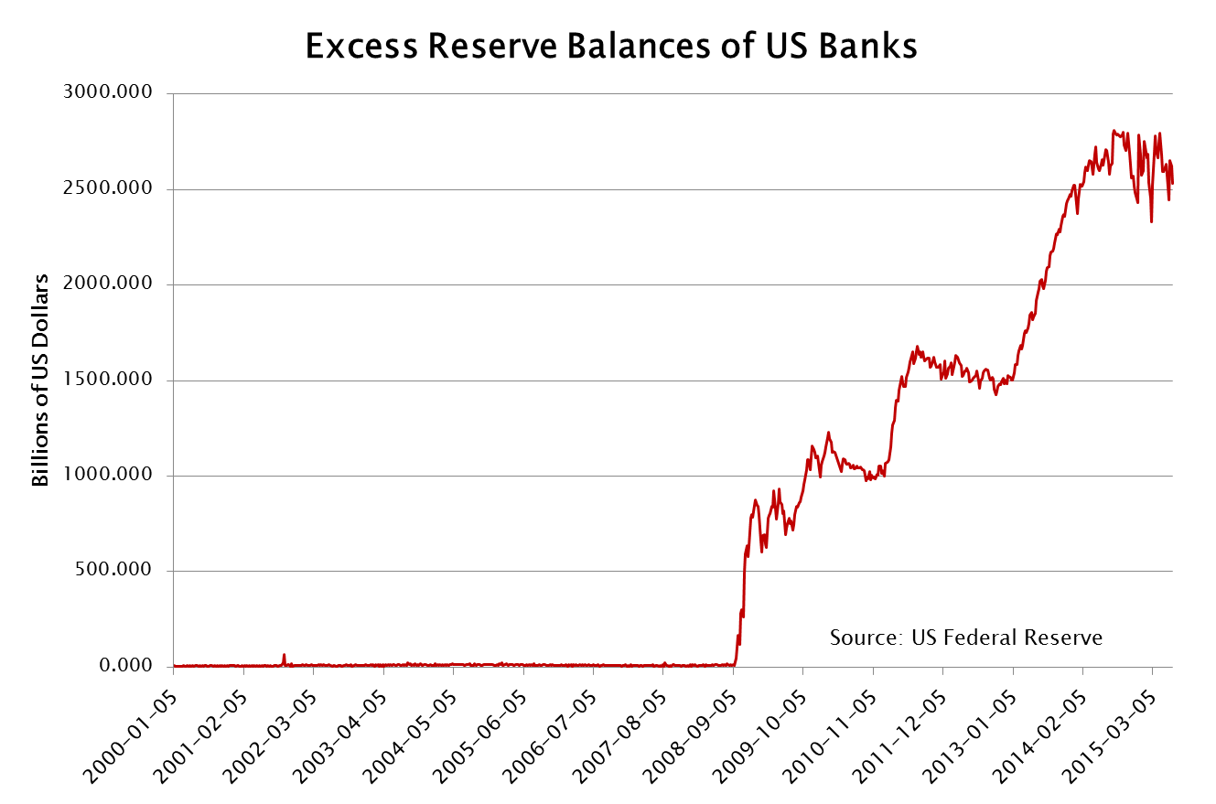
How the United States Bounced Back

Slide 7
How the United States Bounced Back
The FDIC also worked to stem the financial turmoil by increasing deposit insurance limits and guaranteeing bank debt
Congress established the Troubled Asset Relief Pro-gram (TARP) in October 2008, part of which was used by the Treasury to inject much-needed capital into the nation’s banks
The Treasury and Federal Reserve ordered the 19 largest bank holding companies to conduct comprehensive stress tests in the spring of 2009, to determine if they had sufficient capital to withstand further adverse circumstances—and to raise more capital if necessary
Once the results were made public, the stress tests and subsequent capital raising restored confidence in the banking system

Slide 8
How the United States Bounced Back
The effort to end the recession and jump-start the recovery was built around a series of fiscal stimulus measures
Tax rebate checks were mailed to lower- and middle-income households in the spring of 2008; the American Recovery and Reinvestment Act (ARRA) was passed in early 2009; and several smaller stimulus measures became law in late 2009 and early 2010

Slide 9
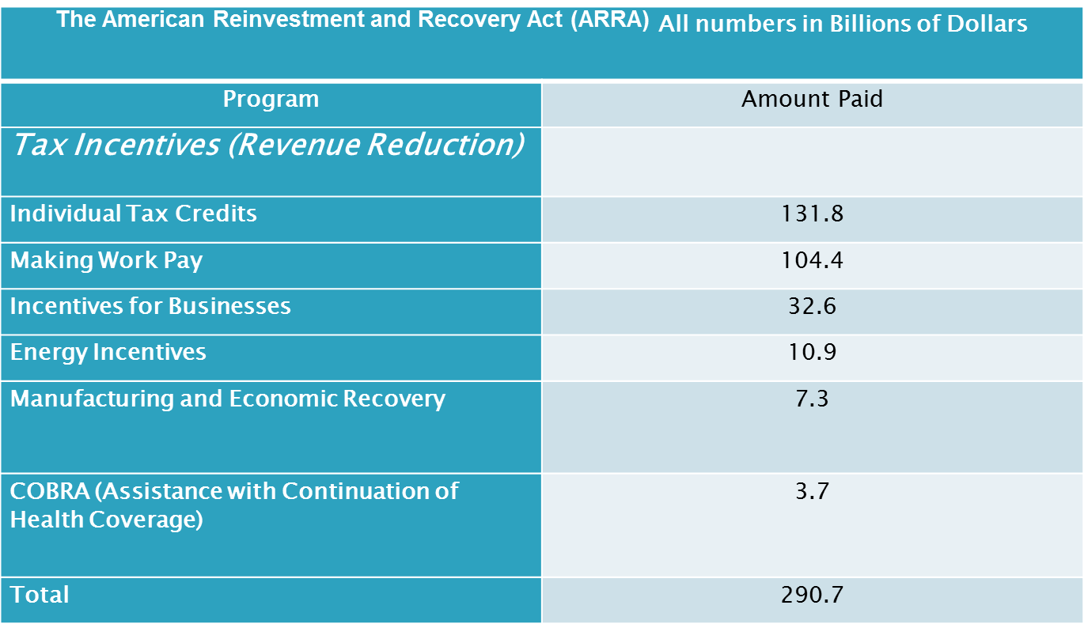
How the United States Bounced Back

Slide 10
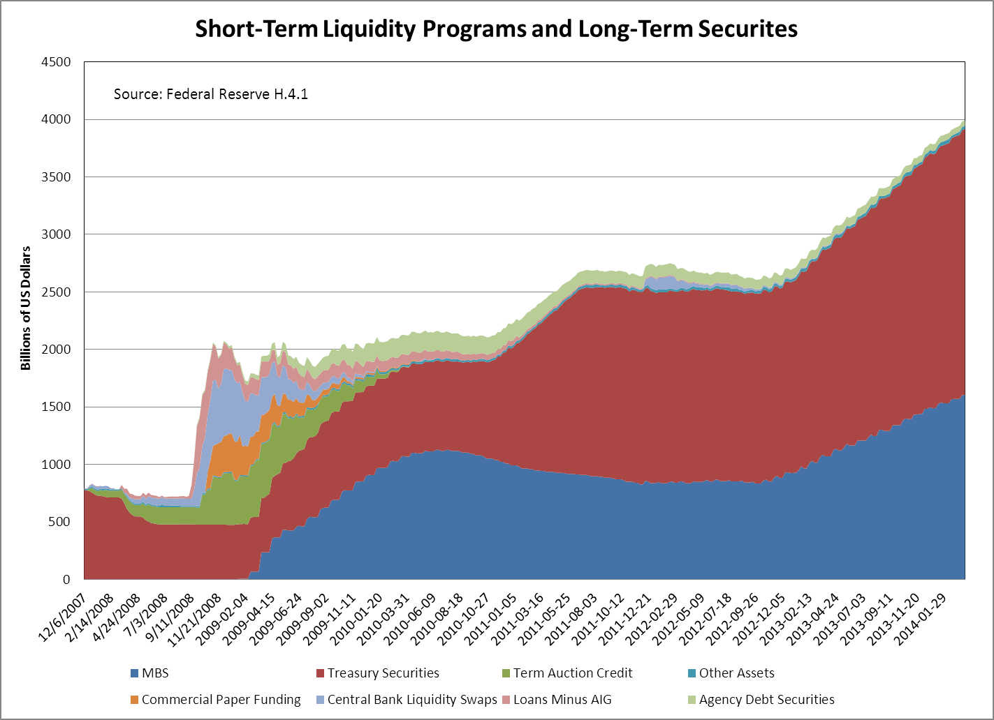
How the United States Bounced Back

Slide 11
Summary of the actions taken to solve the crisis
Monetary policy easing(lowering federal funds target)
Liquidity support provided by Federal Reserve through collateralized lending programs
FDIC expanded guarantees
Capital injections by government
Stress tests on largest banks
Programs to avoid home foreclosures and agency mortgage asset purchases by Federal Reserve to support mortgage market

Slide 12
Conclusion
Disentangling the effects of fiscal and monetary policy is almost impossible because the effects of the two policies occurred simultaneously.
It is almost impossible to disentangle the effects of the three fiscal stimuli from the fiscal automatic, or built-in, stabilizers of the US economic system

Slide 13
References
Gavin, M., & Perotti, R. (1997). Fiscal policy in latin america. NBER macroeconomics annual, 12, 11-61
Mian, A., & Sufi, A. (2010). The great recession: Lessons from microeconomic data. American Economic Review, 100(2), 51-56
Rajan, R., & Zingales, L. (1998). Financial development and growth. American Economic Review, 88(3), 559-586

